Slide 1
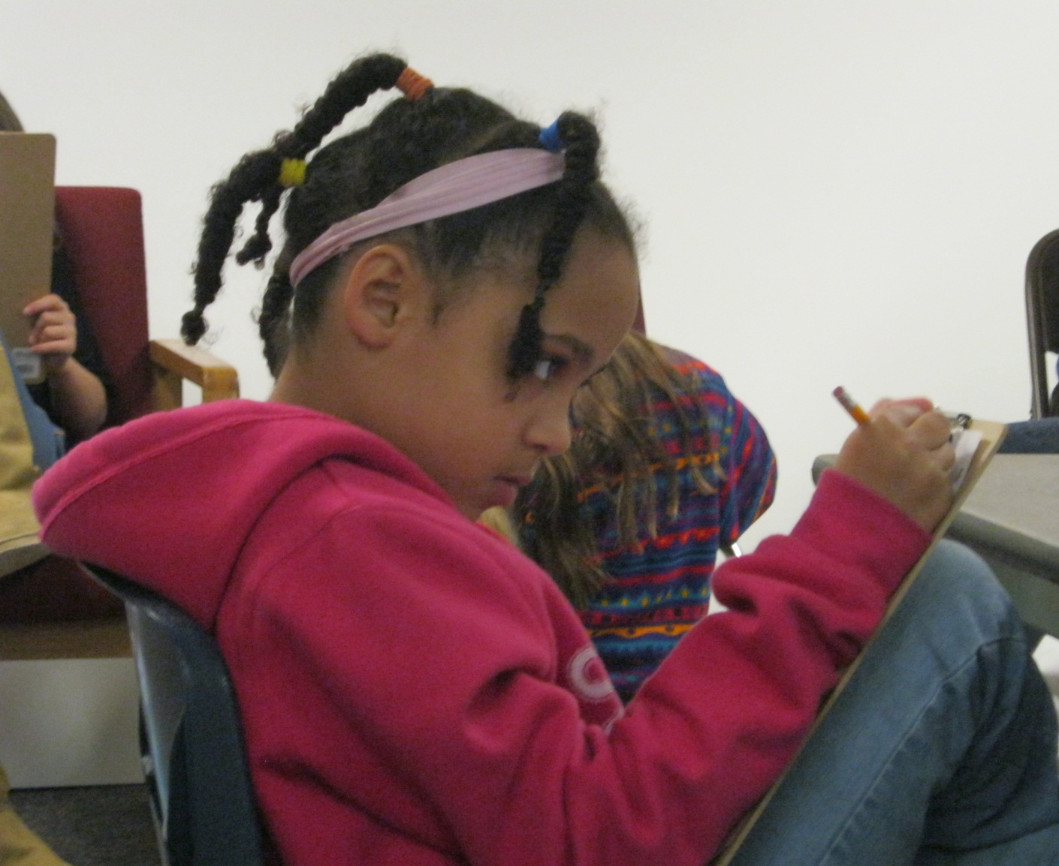
Pencils, scratch, scratch, scratch
A world unfolds in my head,
The world created through words.
Eli, 7th grader

Slide 2
Lake Erie Ink (LEI) provides high quality out-of-school activities and in-school project-based programs for youth which improve literacy, writing fluency, creative expression, and critical thinking in a safe and nurturing space.

Slide 3
LEI Strategy- Effective focus on Writing
After-School programs
Evening Workshops
Weekend Workshops
Direct Curricular Support to teachers
Publishing and Presentations
Engaging the community
Lake Erie Ink provides creative expression opportunities and academic support to youth in the Greater Cleveland community.
How do we do this?

Slide 4
Since June 2011, LEI has…
Served over 218 unduplicated students on-site.
Offered 3 creative writing summer camps (2011), with 5 more in 2012, serving 20-25 students in each.
Established the Ink Spot, an after school homework help and creative writing space for 20-25 4th-8th graders
Held weekly evening and monthly weekend workshops for all ages
Hosted 5 Teen Cafe/Open Mic Nights
Facilitated off site project based programs for 3 other out of school programs.
Provided quality project based programming in 7 different schools.

Slide 5
Who We Serve…
Since June of 2011, LEI has served over 218 unduplicated youth on site, representing over 20 schools in 7 public school districts (including CH-UH, Cleveland, Euclid, Shaker, Solon, and Orange), and at least 4 private schools.
Of youth participating during the 2011-2012 school year—
44% self-identified as Caucasian
36% self-identified as African American
8% self-identified as bi-racial
2% self-identified as Asian
2% self-identified as Latin(a)
And 6% did not self-identify.
Of total quarterly registered participants:
40% qualify for free or reduced-cost lunch
16% received full scholarships for registration.
Parents of 11% of quarterly program participants stated that their child had a diagnosed or suspected learning disability or issue.

Slide 6
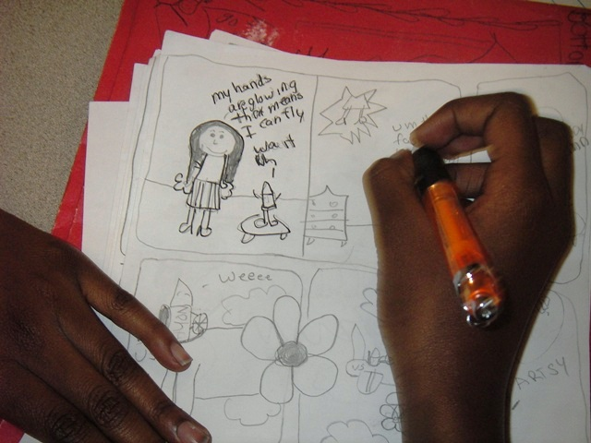
This year, Lake Erie Ink provided project-based writing curricula to students and staff in 12 different locations, serving over 850 students.

Slide 7
Off Site Programs
Lake Erie Ink co-facilitated a Scenarios USA program on “Gender, Power and Relationships” at Options, a CH-UH continuation high school. The program culminated in a national screenplay contest. One student was a semi-finalist.
***
Lake Erie Ink supported a poetry club at Cleveland Heights High School that culminated with students participating in Slam U at Playhouse Square.
***
Lake Erie Ink worked with Aspire and Open Doors Alumni High School students on college and personal essays.
***
Lake Erie Ink designed & taught 7 creative writing units in 4 elementary schools in CH-UH and 1 elementary school in Cleveland, covering topics such as poetry and figurative language, short fiction, fairy tales, comics, & plays. Four of these units culminated in publication of class books.
***
Lake Erie Ink collaborated with teachers and parents at Fairfax Elementary School to help bring back the Young Authors’ Conference so that 400 students could publish their own books.
***
Lake Erie Ink provided a residency at Communion of the Saints in Cleveland Heights, teaching a poetry unit to155 4th-8th graders.

Slide 8
Theory of Change
Lake Erie Ink programming derives from academic evidence about “what works” to achieve desired outcomes, and is based on a clear Theory of Change.

Slide 9
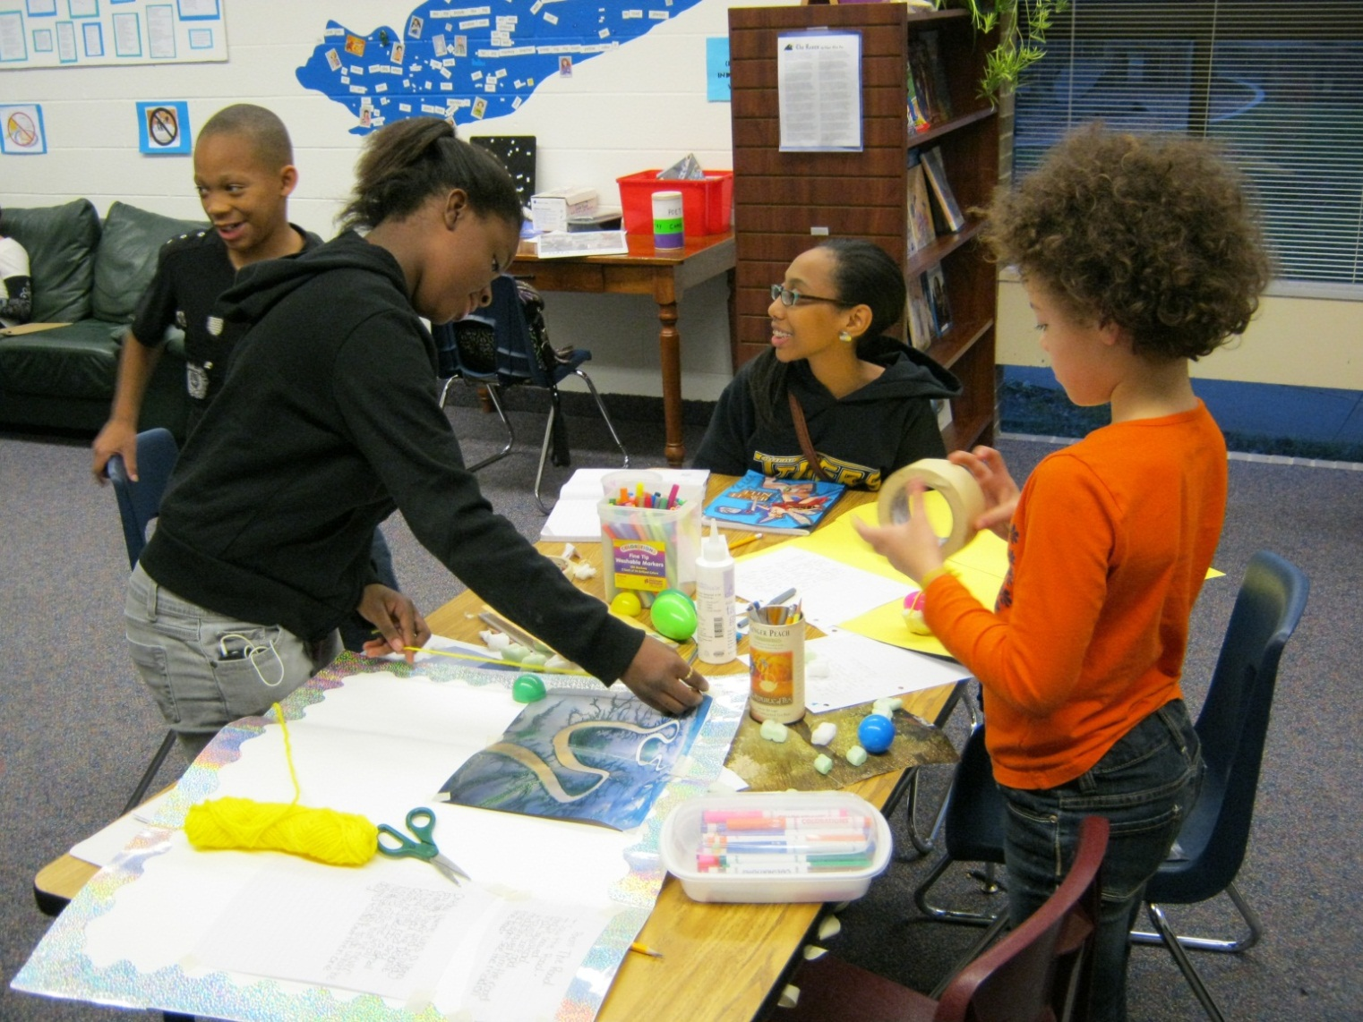
If youth learn in supportive, engaging environments, in which they can explore their creativity and express themselves, then they become more confident students and citizens of the community.

Slide 10
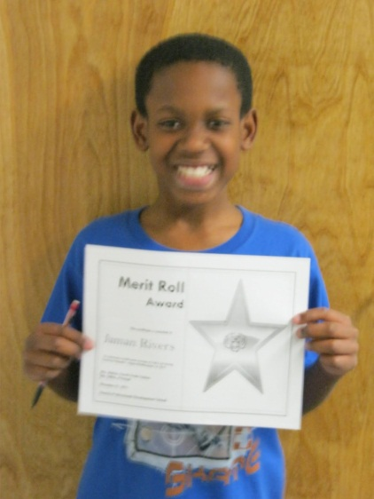
If youth are provided with a safe and supportive place to complete homework after school, then their connection to school increases, as does their confidence in themselves as students, often resulting in better grades and improved study habits and organizational skills;

Slide 11
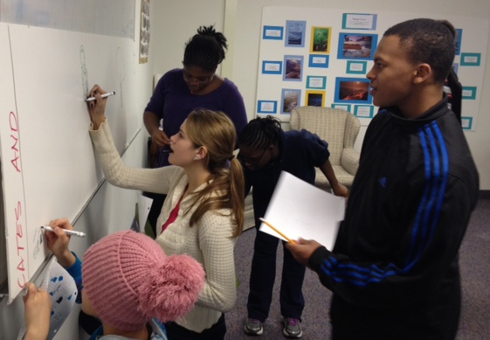
If youth are given the opportunity to collaborate and share creative work, then they will recognize their commonalities and accept and value their differences;
Words that Change the World—Hip Hop Project with DeeJay Doc

Slide 12
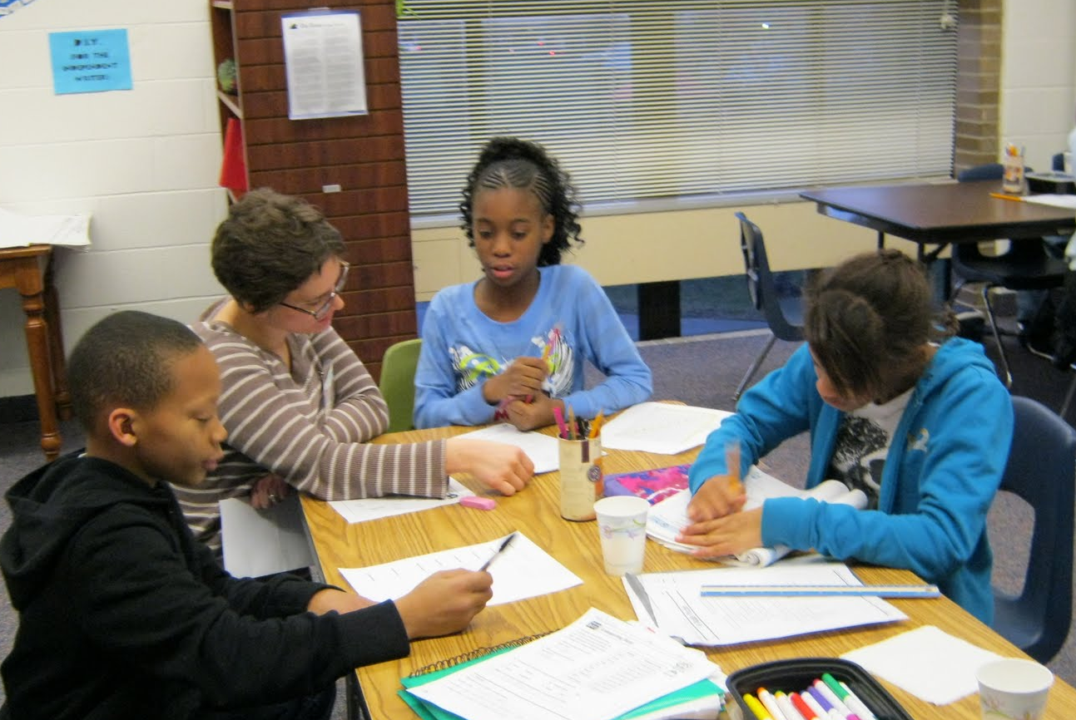
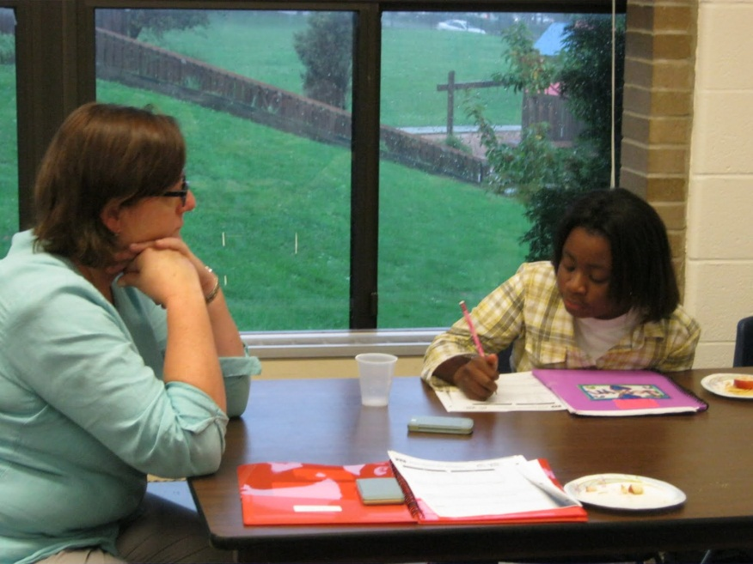
If youth have opportunities to engage with adult volunteers, then their communication and interpersonal skills will increase as a result of informal mentoring and positive role models.

Slide 13
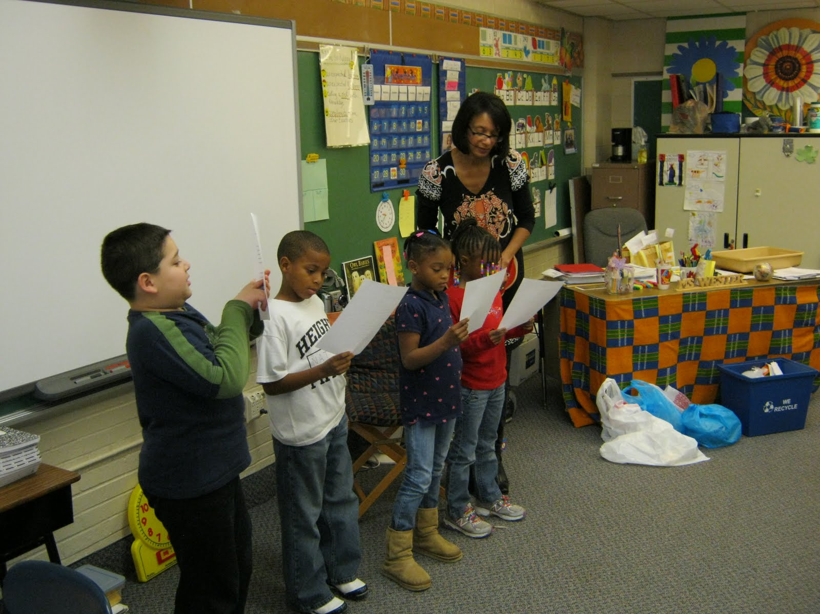
If teachers collaborate with LEI staff to provide engaging writing workshops for their students, then they will replicate the creative writing techniques in their curricula or expand the techniques they already utilize.

Slide 14
LEI’s Successes-Partnerships
LEI continues to develop programs with Heights Library
LEI supported and mentored students involved in Slam U through Cleveland Heights High School and Playhouse Square.
LEI facilitated college essay writing workshop for Aspire alumni program.
LEI developed curriculum and facilitated programming for Open Doors Academy High School Alumni in three communities (Miles Park, Cleveland Heights, and Euclid).
LEI staff trained in and facilitated Scenarios USA for CH-UH’s continuation high school.

Slide 15
LEI’s Successes— Community Connections
LEI introduced students to a broad spectrum of professional artists, including writers, musicians, graphic artists, journalists and bloggers.
DeeJay Doc’s series of 6 workshops for the afterschool and evening programs culminated in collaborative recordings of hip hop songs (Words that Change the World) and a CD release party.
LEI partnered with Mac’s Backs for World Book Night, distributing free books to parents and students at LEI.

Slide 16
LEI’s Successes— Our Organization
After securing the fiscal sponsorship of Greater Cleveland Neighborhood Association, LEI became a separate 501c3. We remain connected with GCNCA due to our continued contract for their financial and IT services.
LEI developed a dedicated, working board, advisory board and committees.
LEI launched a modest networked computer lab with six laptops for student use. The lab also includes a networked printer and binding machine for student publications.
LEI collected in-kind donations to furnish our new site, and we are actively pursuing other sources of in-kind support.
LEI increased revenue by offering writing residencies to private schools and other youth-serving organizations.
LEI held a fall celebration and spring benefit in Cleveland Heights to build community support and raise funds.
LEI held its first annual campaign.
LEI joined BVU and Cuyahoga Arts Education Consortium, developing connections with other nonprofits and community partners.
LEI hosted two breakfasts for foundations, organizations, and community members to introduce them to our mission and program.
LEI has been selected as a host site through Northeast Ohio Literacy Corps. Beginning in September 2012, an Americorps Member will serve full-time as the after school Ink Spot and volunteer coordinator.

Slide 17
To Achieve Our Potential, LEI will continue to:
Continue to build collaborative relationships with administrators and teachers in additional school districts and youth serving organizations throughout the Greater Cleveland area
Strengthen our development plan, to secure long-term sustainability
Expand our evaluation models and strategies, to ensure our programming is meeting our performance goals

Slide 18
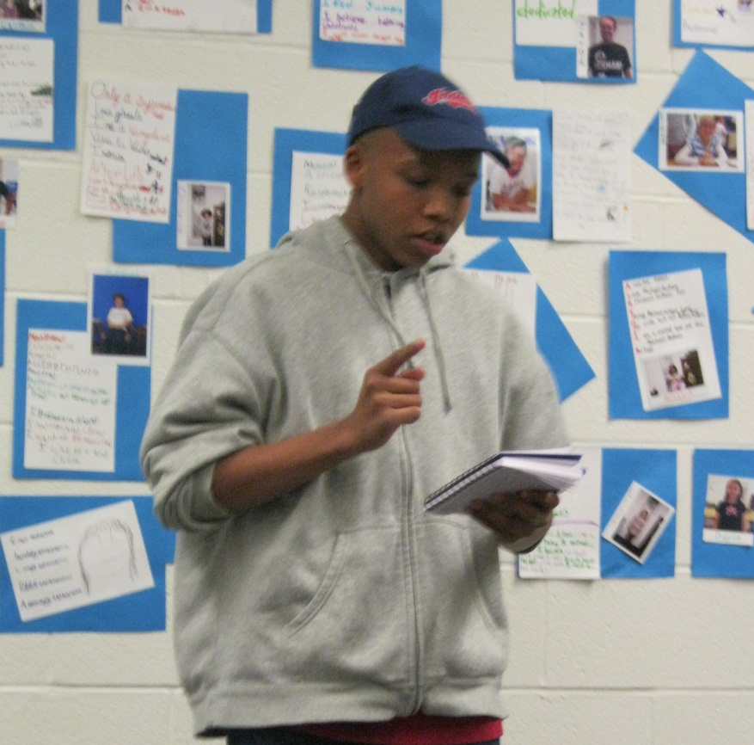
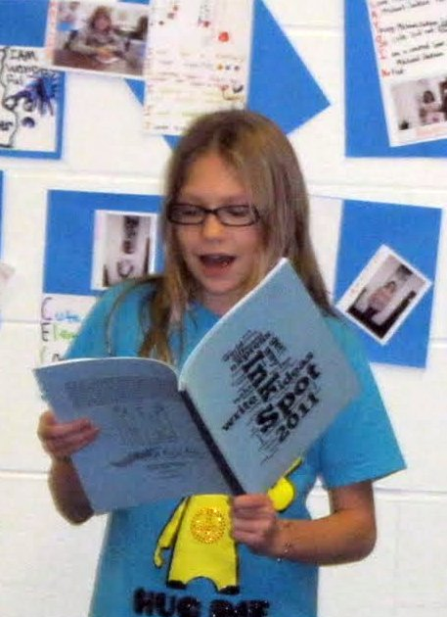
Purple I am blue to yellow, depending on my mood
Like a flower blooming or a rose bushes’ thorns.
I am not a tool, to be used to people’s advantage.
I am not alone in a crowd, for there are people like me.
I am in the worlds I create when I write.
I am not in a movie; this is real.
Anabel

